Slide 1
Tutorial Session - 1
TECHNICAL COMMUNICATION

Slide 2
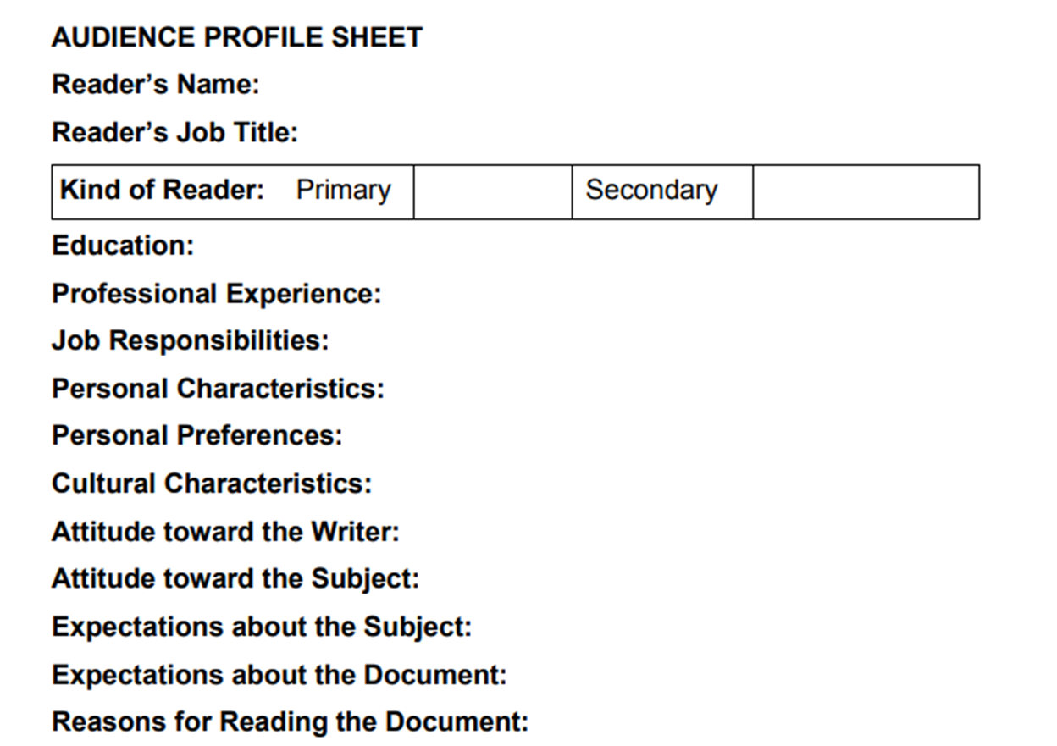
AUDIENCE PROFILE SHEET

